Slide 1
AI Boxing Simulation
Xuyang Wang, Hongzhen Xu, Ziyi Song, Min Sun
Notes:
Hello everyone, today me and my group will present our project on Boxing Simulation.

Slide 2
Background
Goal: Develop a multi-agent system in a battle-royal-like simulation.
Plan: Using PettingZoo to create a dynamic environment with 4 distinct groups, each with unique abilities.
Purpose: Using reinforcement learning (RL) to allow agents to learn and evolve strategies.
Notes:
Our initial goal was to develop a multi-agent system in a battle-royal-like simulation. The original plan involved using PettingZoo to create a dynamic environment with four groups of agents, each with unique abilities. The purpose was to use reinforcement learning to allow our agents to learn, interact, and evolve their strategies in a competitive setting, and how they change strategies while in groups.

Slide 3
Shift in Plan
4 groups of agents
Each group with unique abilities
1 RL training methodology
2 agents
No distinct abilities
2 methodologies for comparison
Add Deep Q-Network
Notes:
As our project progressed, we faced a remarkable amount of challenges for balancing ambition with feasibility, such as the limitation of hardware capabilities and the library's limited extension. Therefore, We simplified our approach from four groups of agents to just two, and removing distinct abilities. However, This transition also allowed us to concentrate on comparing two methodologies and include Deep Q-Networks.

Slide 4
Methodologies
Deep Q-Network with CNN and Epsilon-Greedy Policy
Upper Confidence Bound (UCB) Policy
Notes:
Our methodologies include two policies, one is the epsilon-greedy policy which Hongzhen will introduce, the other being the UCB policy which Ziyi will cover.

Slide 5

Method
Deep Q Network,CNN, Experience Replay, Pooling, random opponent, Reward tuning.
Hongzhen Xu

Slide 6
UCB Policy Zi Yi Song
Upper Confidence Bound (UCB) Policy
UCB_Value = x̄ a+ c √(2 ln(n) / n_a)
Action that currently seems best or action that might get better reward
Notes:
Instead of using Epsilon-Greedy, I used Upper Confidence Bound policy AKA UCB. Here is the expression to calculate the UCB value, and it chooses the action with largest UCB value each time. Let’s look at the expression, The first item is the average reward received from action a so far. And C is a constantt. And then, in this square root, n is the total number of actions take so far. And na is the the number of times action a be taken so far. So, try to understand this calculation, it actually calculates a confidence bound for each action. In this way, it gives us a strategy about choosing the action that currently seems best(based on past experience) or to explore. It can balance it.

Slide 7
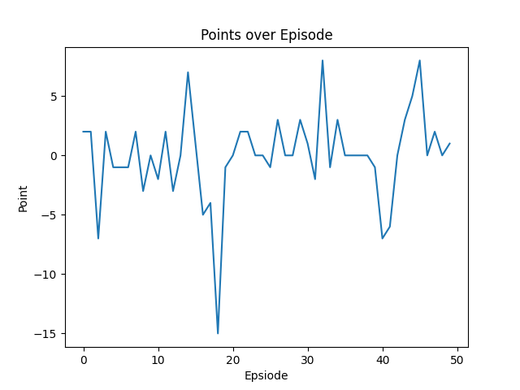
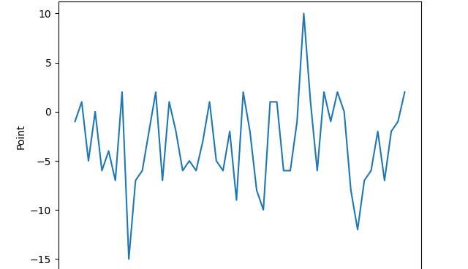
Comparison
Epsilon-Greedy
UCB
Notes:
Here are charts of the first 50 episode of these policies respectively. Since it is the first 50 episodes, it’s more like some random values and we cannot see much signification information from it. Though the average points is higher in the UCB chart. But we can expect that UCB would coverage faster. This is because that as time goes by, UCB dynamically adjusts the level of exploration, the exploration rate naturally decreases.

Slide 8
Real World Application
Robotics
Games
Traffic Management
And more
Notes:
The practical applications of these AI technologies extend far beyond our simplified battle- royal game simulation. In a game industry, reinforcement learning can be used to create more engaging and challenging AI opponents, enhancing the overall player experience; In robotics and autonomous areas, reinforcement learning can enable robots to learn and adapt their surroundings, making them more versatile and effective in complex surroundings. Multi-agent learning can be applied in robotics for controlling and coordinating multiple robots working together to accomplish a common goal.
One of the potential limitations is that we did not stack multiple frames together as input, which would be better that way. Currently we only have one image. As we continue to refine and expand our project, we aim to fix it, and increase the number of agents and possibly introduce more complex environments. We can further explore the capabilities of these AI techniques and their real-world applications.

Slide 9
Thank You!

